Slide 1



MealDest
.

Slide 2
Team Members
Rishi Raj Singh Chauhan
Raj Jaiswal
Rajat Ankel
Parth Vyas

Slide 3
Problem Statement
People with time have become so busy in their lives that not everyone can cook meals for themselves.
Students and working class usually depend on tiffin centers and hostel food for their daily meals.
Although it is observed that majority of these people are not satisfied with the food they get.
With busy lifestyle it is also hard to look for alternatives as it can be time consuming.
No availability of application in market which provides regular healthy food.

Slide 4
Solution
To solve this problem we intend to create a Web and App based platform where tiffin centers, micro and macro kitchens and household moms can list themselves.
People will be able to see ratings from people of how the food tastes which will motivate meal providers to ensure good quality food in order to acquire more customers.
The users will be able to customize which days of the week to order meals and which time of the day as well.

Slide 5
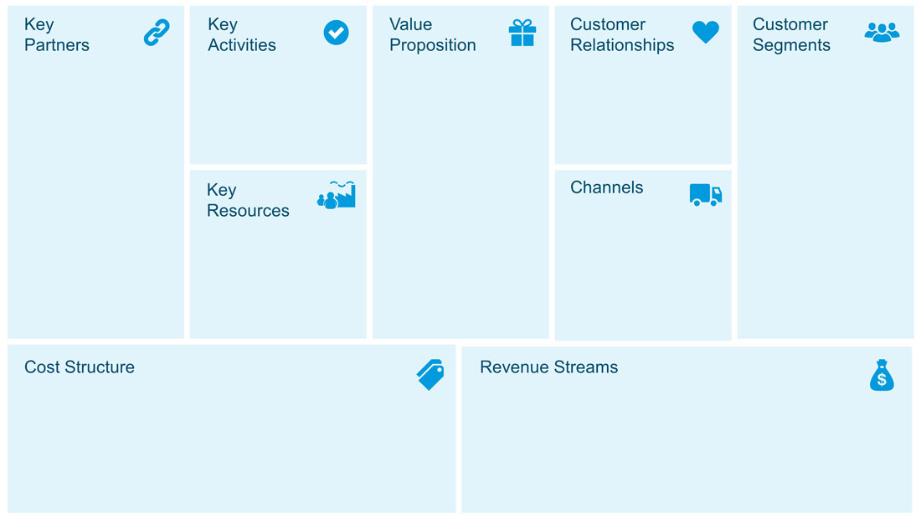
Maintenance of application and website
Delivery of food
Providing home like food at affordable rates while taking care of the quality and hygiene of meals being provided.
Local Meal Providers such as
Tiffin Centers
Mess
Kitchens
Moms with part time food service
Timely delivery of food
Quality assurance
Bachelors
Job Employees
People with Less time to cook
Meal Providers
Delivery personals
Application
Order via application
Direct order
Delivery Charges
Application
Packaging (future)
Monthly Subscription
Promotion by meal providers on app
Commission by adding delivery partners

Slide 6
Learning and Improvement In Coding skills Initial required ground work for startup Market research How to devise a plan for startup Social Skills

Slide 7
Future Aspects
Customer can customize on which days the food not to be served
Connecting all the messes
Setup a meal providing center of our own
Hire delivery partners
Connect more and more partners all over Indore and more

Slide 8

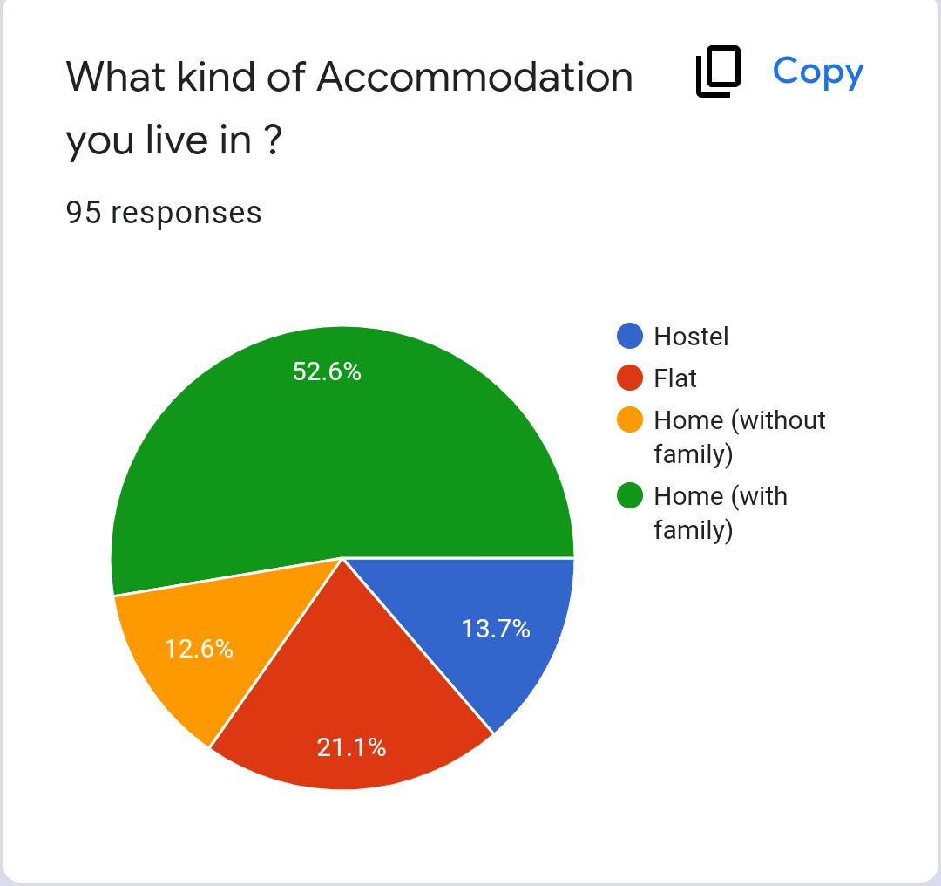
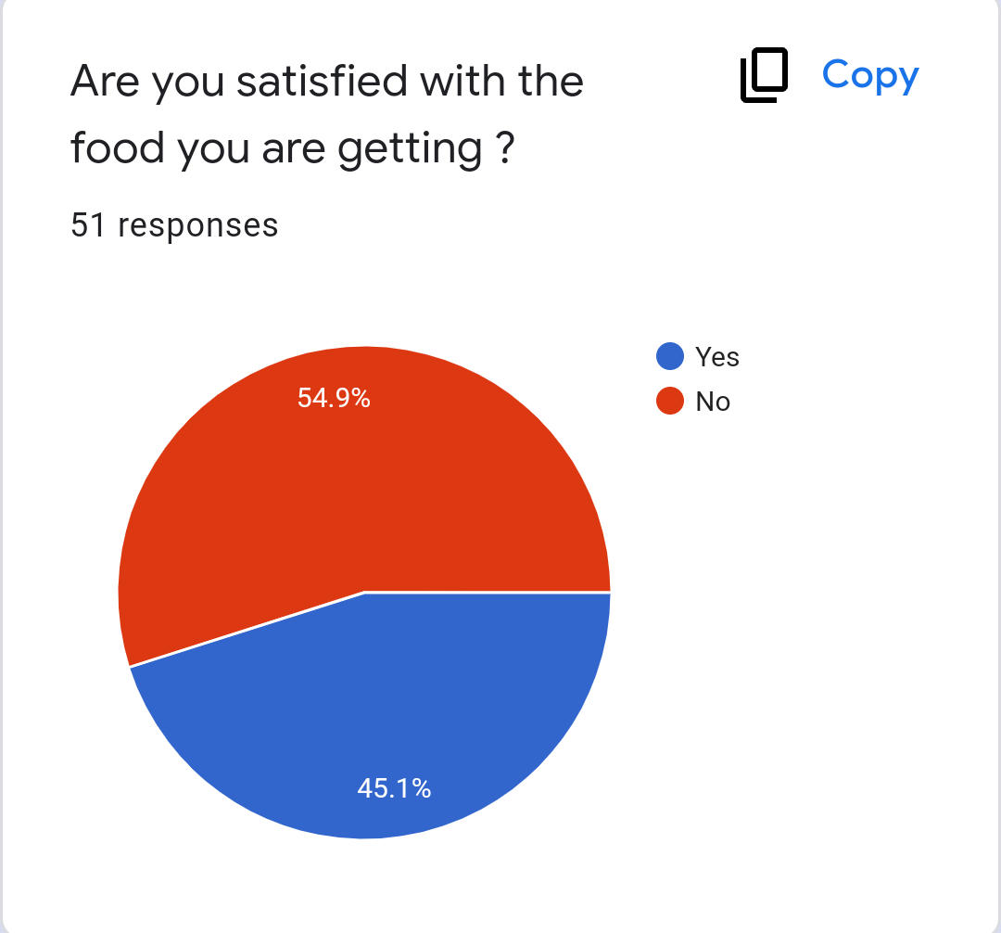
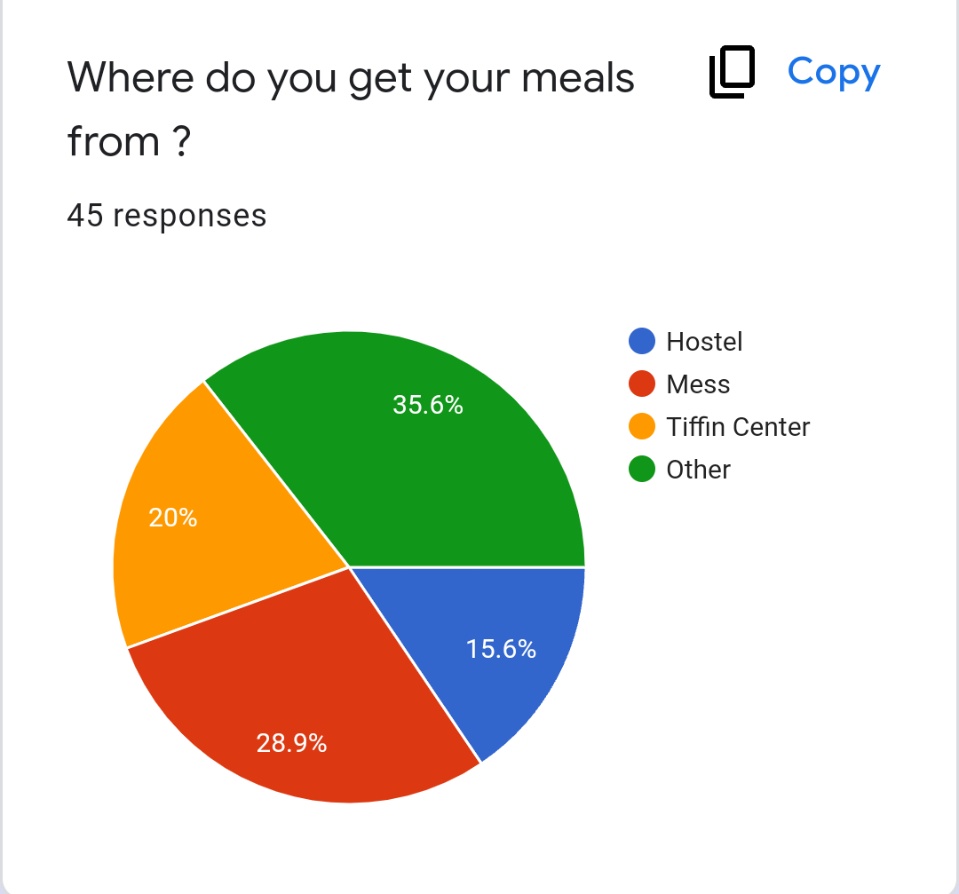
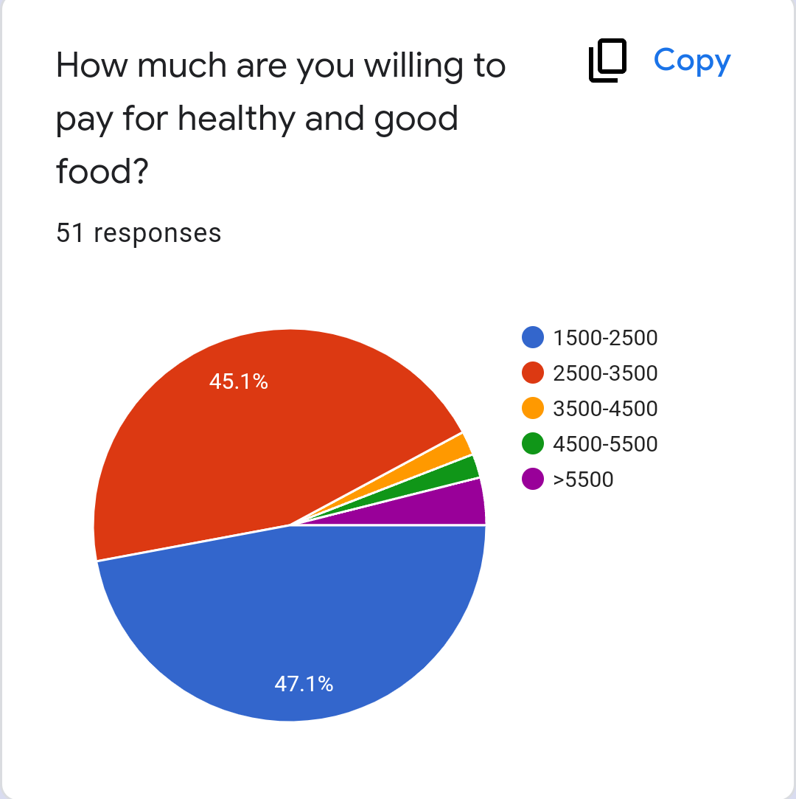

Slide 9
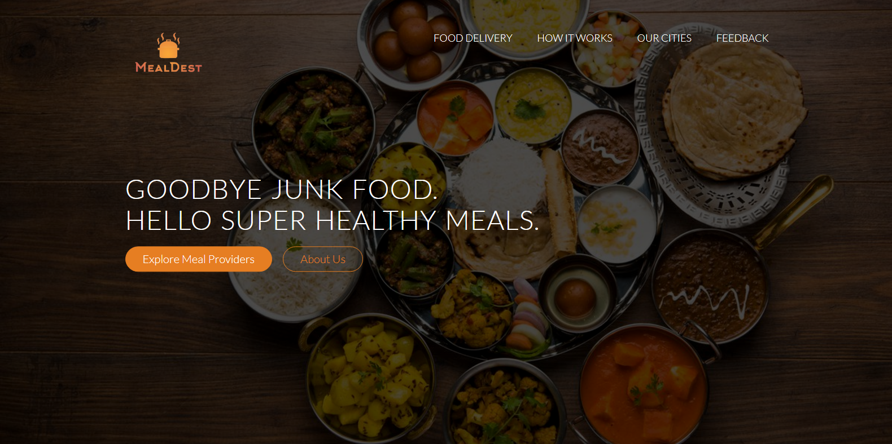
Desktop Software

Slide 10
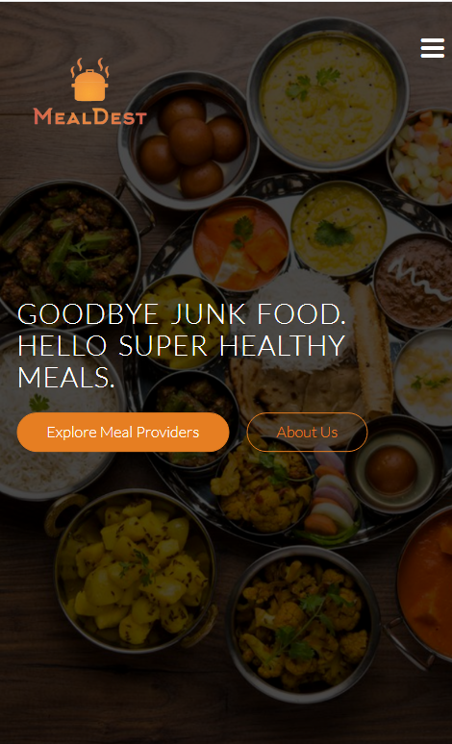
Mobile Application

Slide 11
Thanks!
DO YOU HAVE ANY QUESTIONS?
mealdest@gmail.com
+91 7043711233
+91 9301131079
Website : mealdest.c1.biz
.
.

